Slide 1
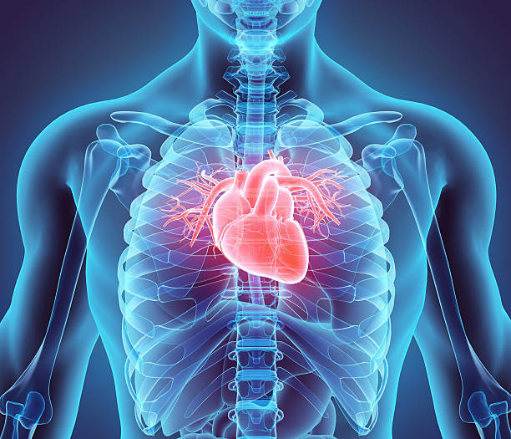

Heart Disease
Prediction Using Machine Learning
Early Detection and Risk Assessment

Slide 2
Why I Chose This Project
  Heart disease is a leading cause of death
worldwide.
  Early prediction can save lives and reduce medical costs.
  Combines healthcare and AI/ML for practical problem-solving.
  Opportunity to assist doctors with data-driven insights.

Slide 3
Project Description
  Objective: Predict the likelihood of heart disease in patients.
  Dataset: Patient data from Kaggle (age, cholesterol, blood pressure, etc.)
  Methodology:
  Data Preprocessing (cleaning, encoding, scaling)
  Model training: Logistic Regression,SVM,Desicion Tree,Random Forest,KNN
  Model evaluation: Accuracy Score
  Prediction Output: Heart Disease → Yes or No

Slide 4
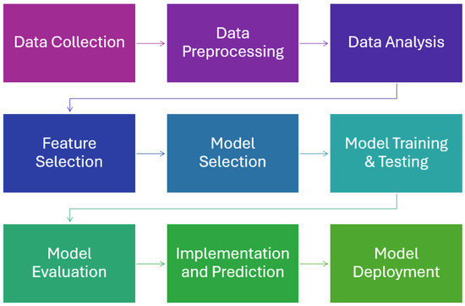
workflow of Machine Learning

Slide 5
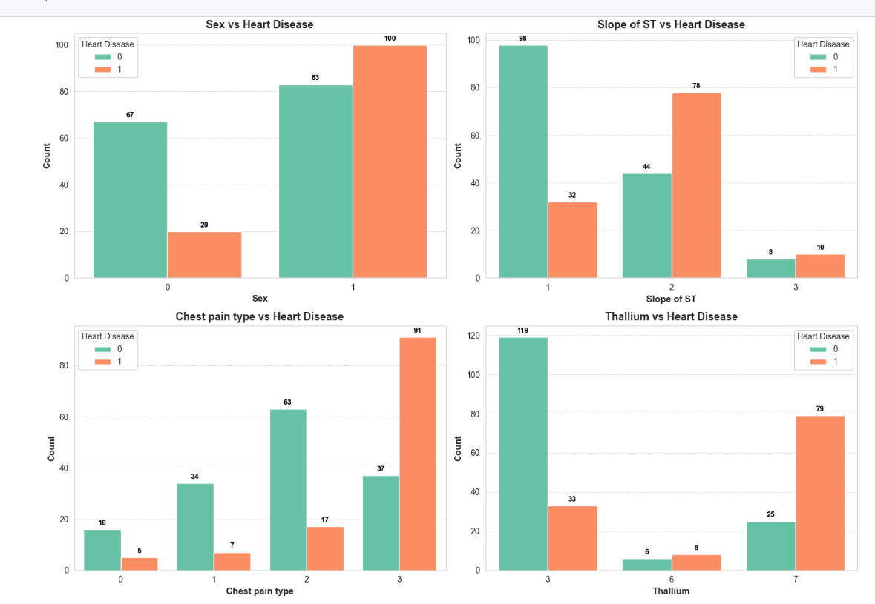
Data Visualization

Slide 6
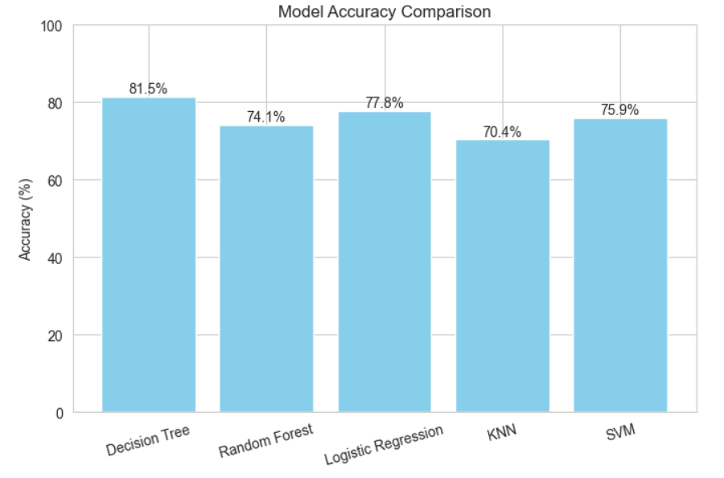

Slide 7
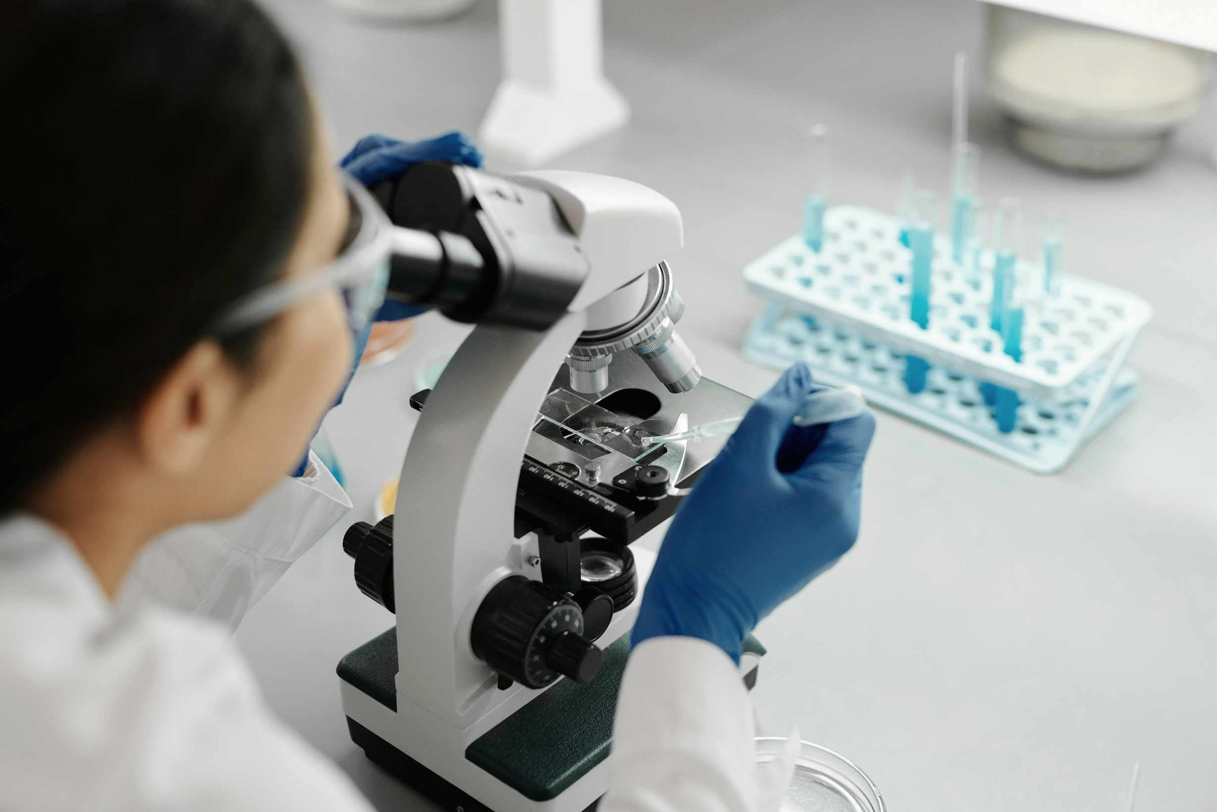
Results & Impact
  Multiple machine learning models predict high-risk heart disease patients effectively.
  Accuracy scores show each model’s performance for comparison.
  Helps doctors make informed decisions quickly.
  Reduces unnecessary tests and optimizes healthcare resources.

Slide 8
Thank You
Model Efficiency: The project successfully delivered a highly accurate machine
learning model that effectively predicts heart disease, validating the use of for
early risk assessment.
Future Impact : To enhance robustness and generalizability, future work will
focus on integrating a larger, more diverse patient
dataset and validating the model's performance in a real-world clinical environment.

